Slide 1

Flight Analysis
Yang Liu, Junrui Wan,
Linghao Yang, Curtis Zhuang
Dec. 11th, 2021

Slide 2


Business Objectives
EDA
Modeling
Model Comparison
Feature Importances
Conclusion
Contents

Slide 3
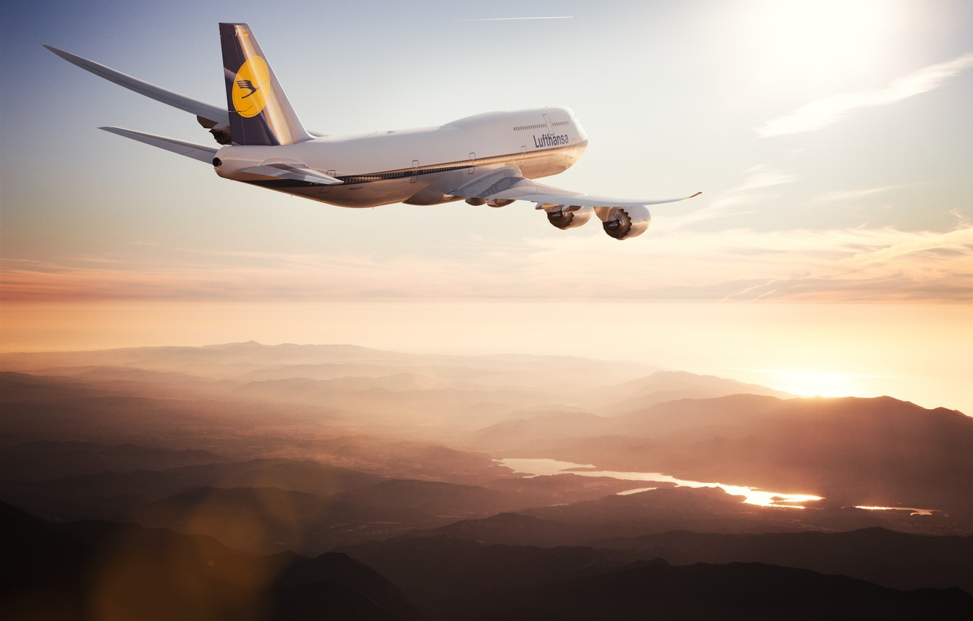
Background and Business Objectives

Slide 4

Problem Background
Flight delay and cancellation may pose financial losses, dissatisfaction, time losses, among many issues for travelers. And as traveler, it is always to know ahead of time how likely their flight may run into such issues so they can either avoid booking the flight or get prepared.

Slide 5
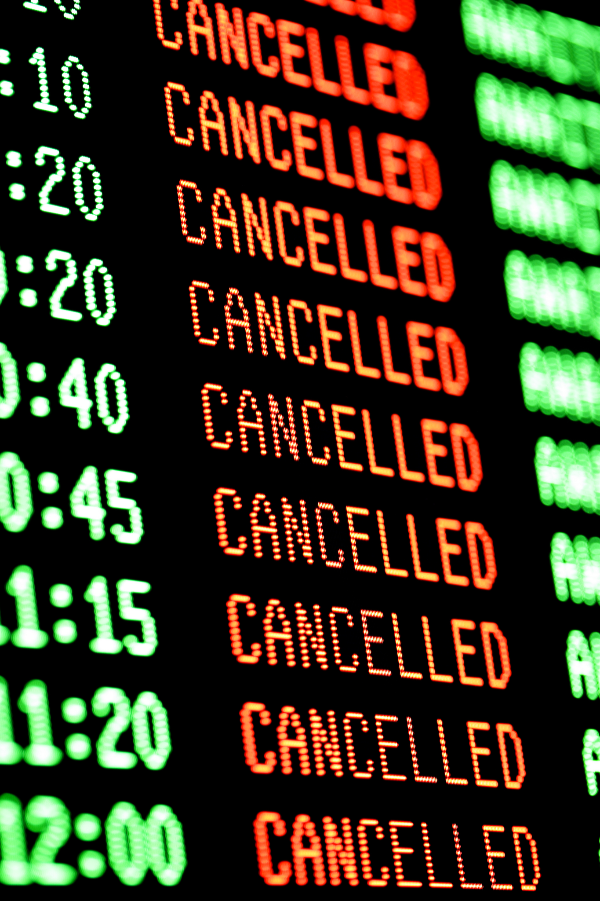
Business Objectives
Flight delay and cancellation are inevitable and play an important role in both profits and loss of the airlines. They not only irritate air passengers and disrupt their schedules but also cause a decrease in efficiency.
Our main goal is to find out the key factors that lead to cancellation and delay.

Slide 6
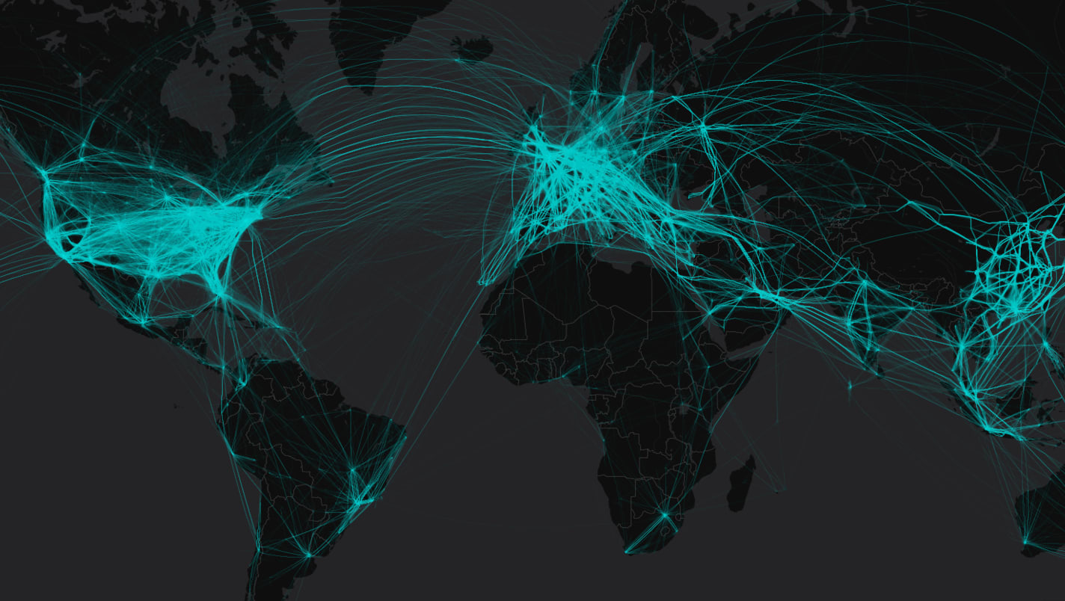
Exploratory Data Analysis

Slide 7
EDA
Flight arrival and departure details for all commercial flights within the USA
From October 1987 to April 2008
120 million records, 21GB
Key variables:
Date
Origin, Dest
Distance
Cancelled
ArrTime, DepTime, CRSArrTime, CRSDepTime
Delay(Carrier, Weather, NAS, LateAircraft, Security)

Slide 8
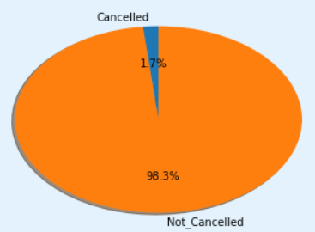
EDA - Cancellation Analysis
Most of the flights are not cancelled

Slide 9
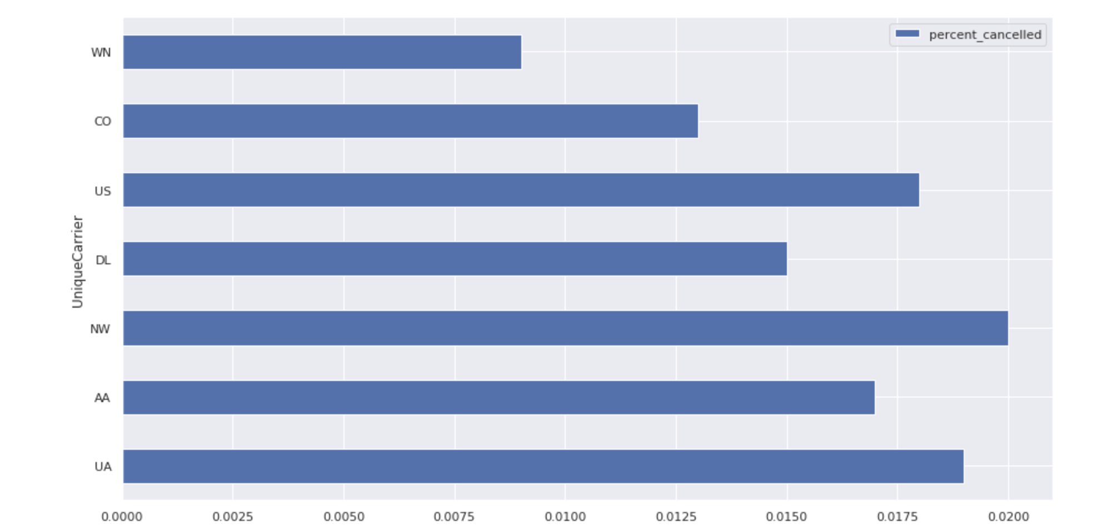
EDA - Cancellation Analysis
Cancellation and UniqueCarrier

Slide 10
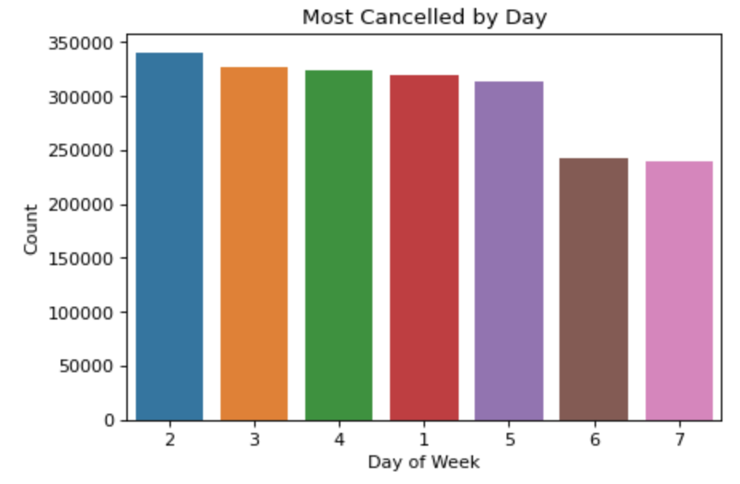
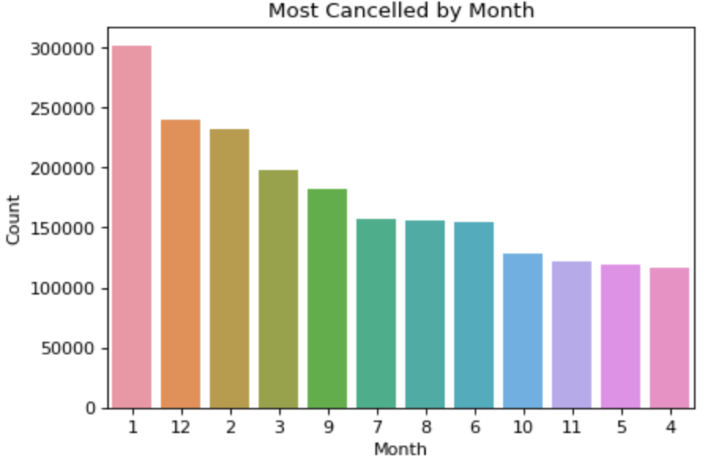
EDA - Cancel Analysis - Time
Most cancelled flights by Time:
Winter times sees more flight cancellations followed by summer
Week days sees more flight cancellations than weekends

Slide 11
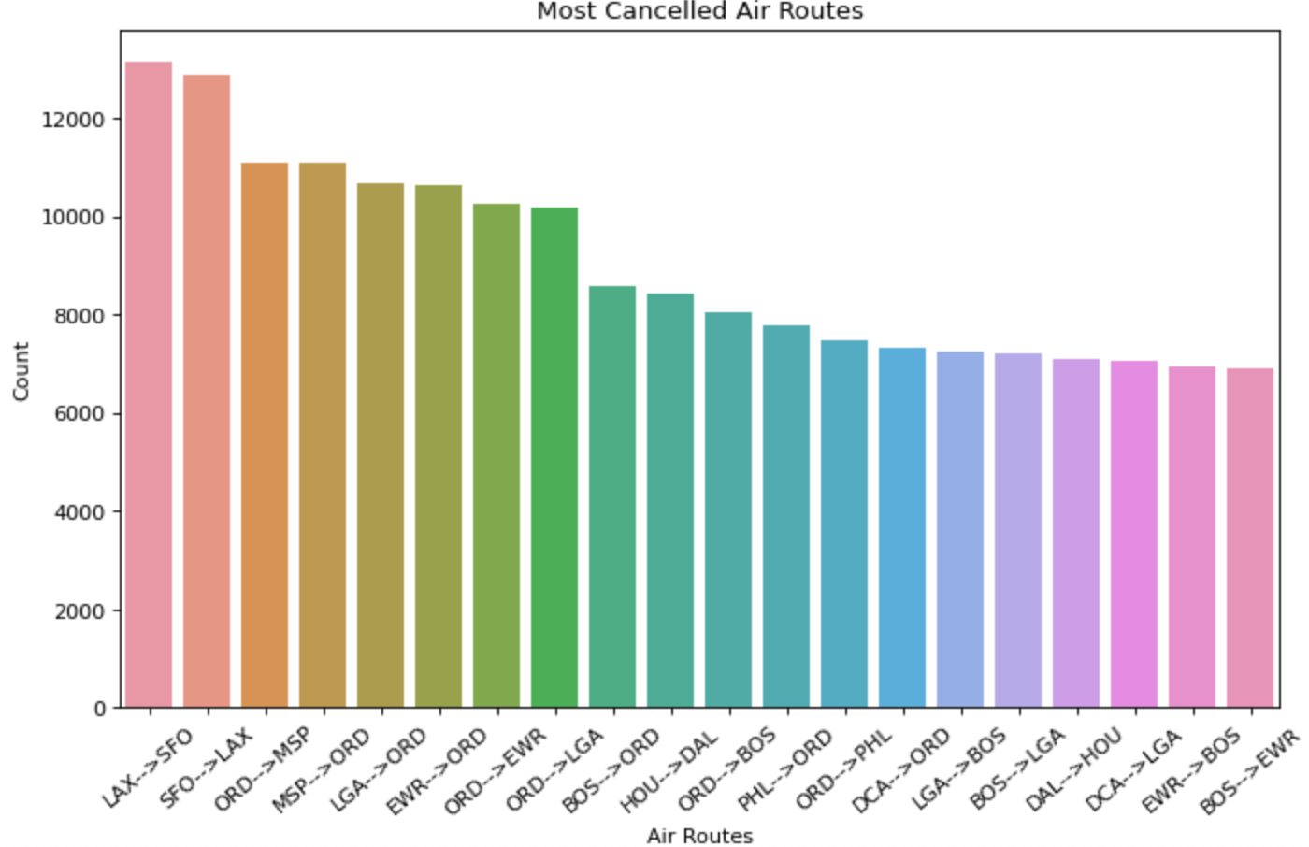
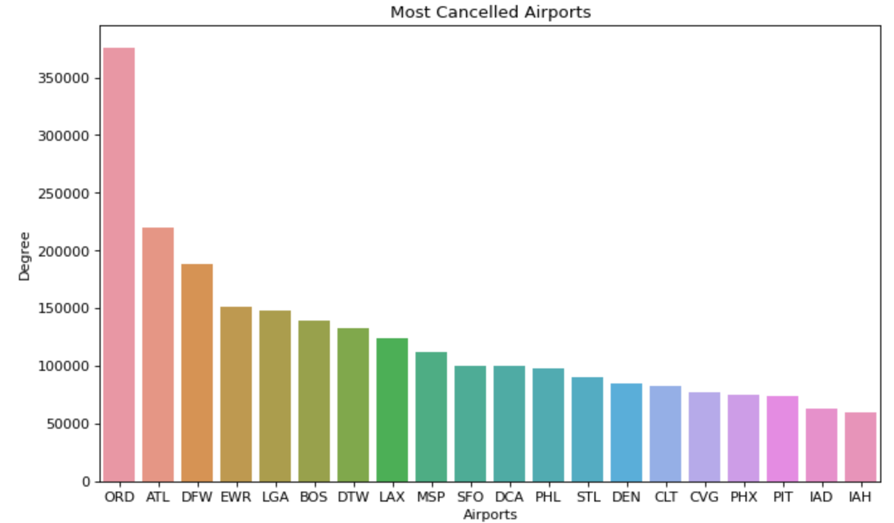
EDA - Cancel Analysis - Airport
Most cancelled flights by Airport:
LAX to SFO is most cancelled route both direction followed by MSP to ORD
ORD most cancelled airport followed by ATL
Flights cancellation are often bi-directional

Slide 12
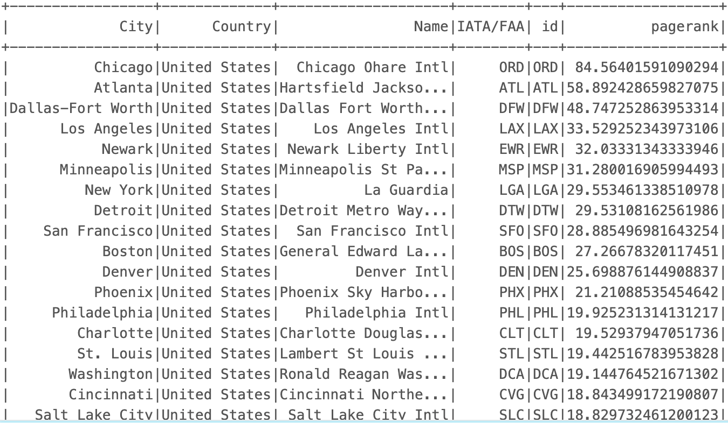
Cancellation Analysis - Page Rank

Slide 13
EDA - Cancellation Analysis
Cancelled flights make up 1.7% of total flights which is much larger than expected
ORD is the airport that receives most cancellations compared to others
Maybe due to weather
ORD is also the busiest airport based on analysis
Flights are more likely to be cancelled during Winter months followed by Summer
Flights are more likely to be cancelled during weekdays, especially on Tuesday
NorthWest, United, USAirways has highest cancellation, SouthWest sees the lowest

Slide 14
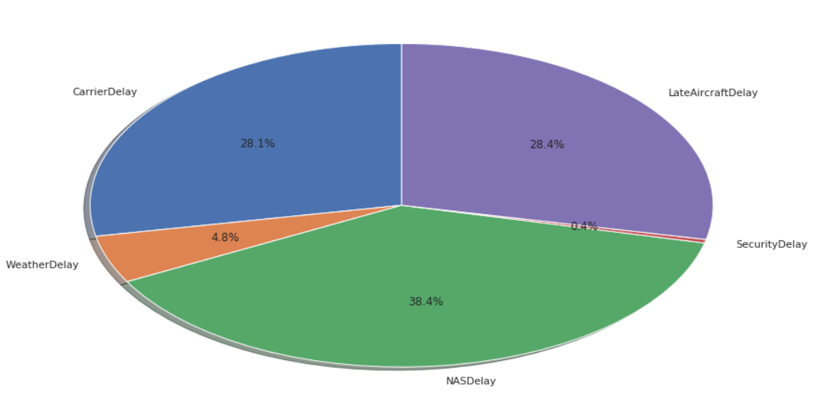
EDA - Delay Analysis
Most of the delay are NAS Delay, Late Aircraft Delay, and Carrier Delay
We will see how different delay reasons has different delay results

Slide 15
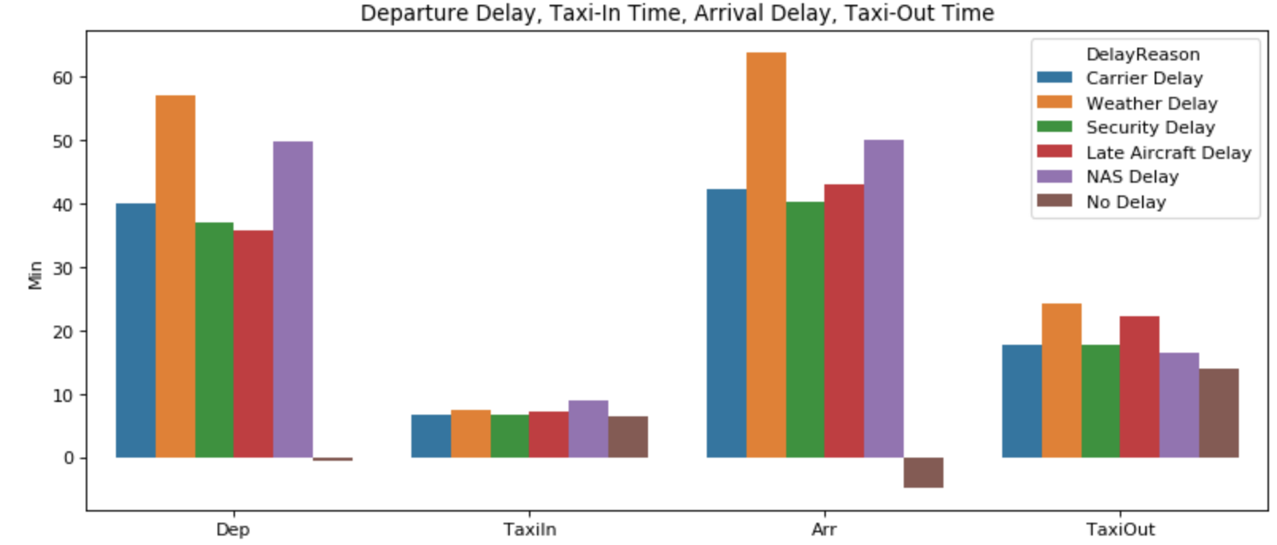
Delay Analysis - Delay Reason
When observing delay time on average, we see Weather leads to longest wait times
Weather also leads to longer time to Taxi-In and Taxi-Out compared with other delays
We will investigate further to see if delay types do make a difference

Slide 16
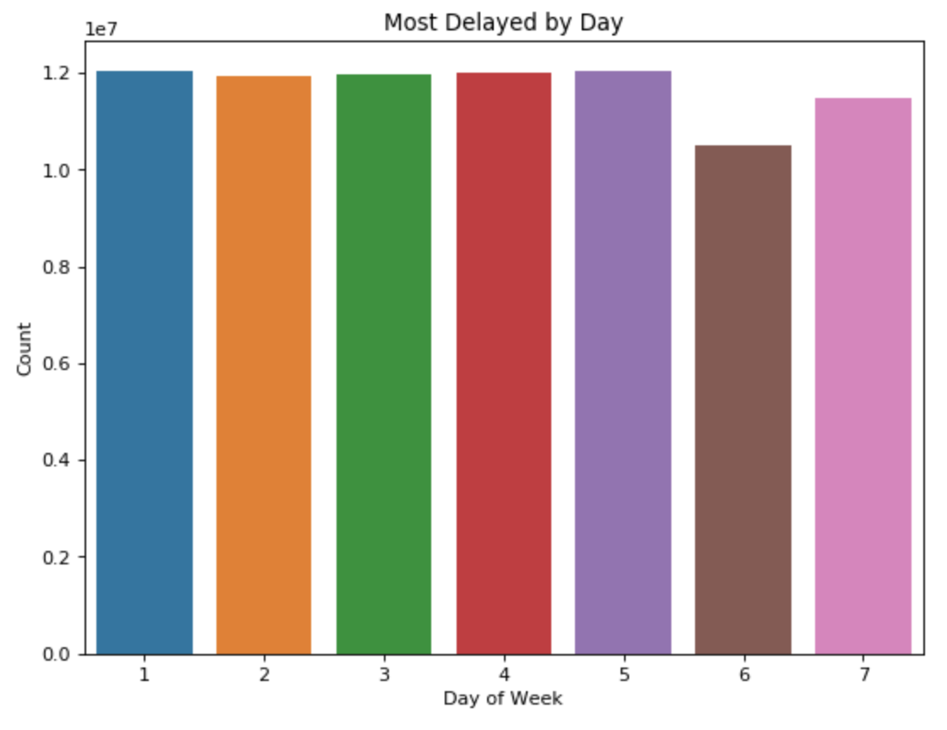
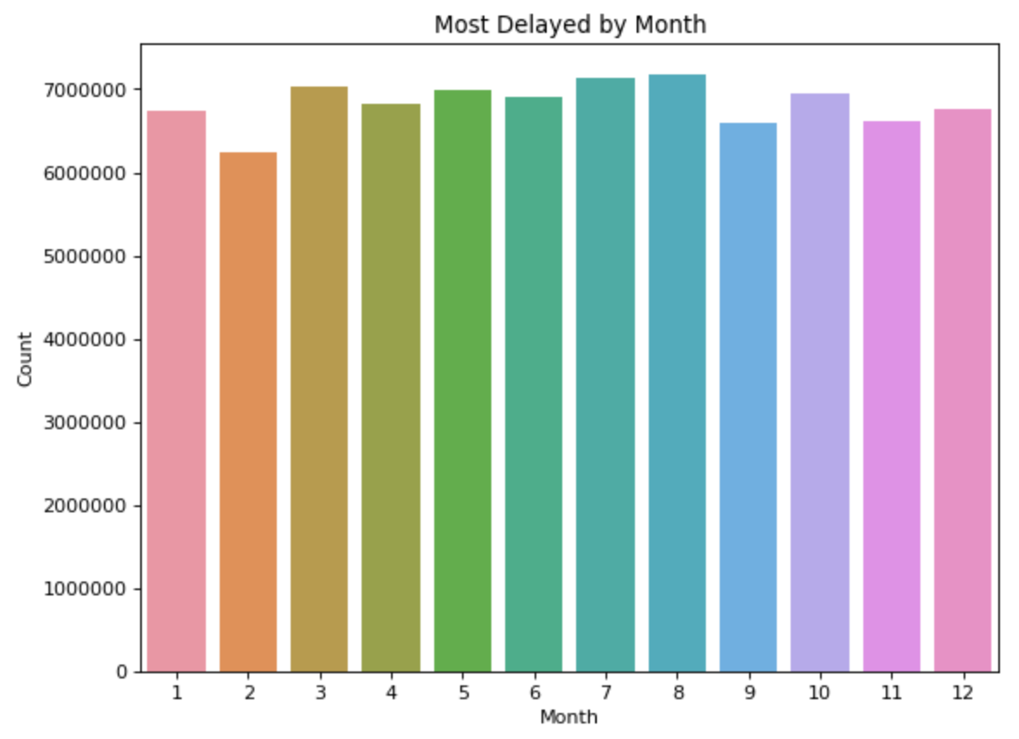
EDA - Delay Analysis - Time
Most delayed flights by Time:
Weekdays see more delays than weekends
Summer days has more delays followed by winter
Notes:
Summer days showers so delay while winter might see more extreme weather so cancel

Slide 17
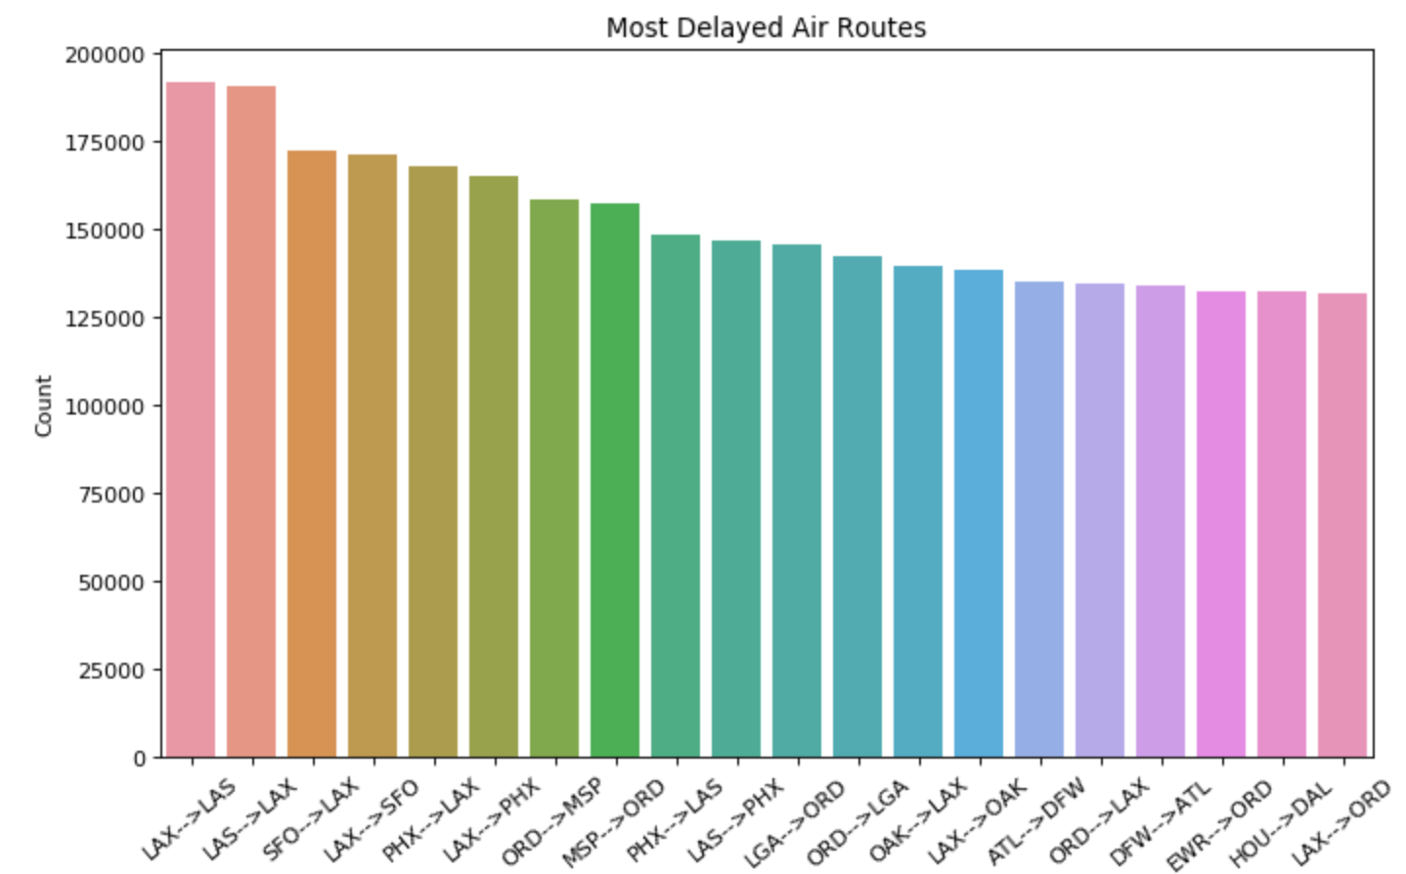
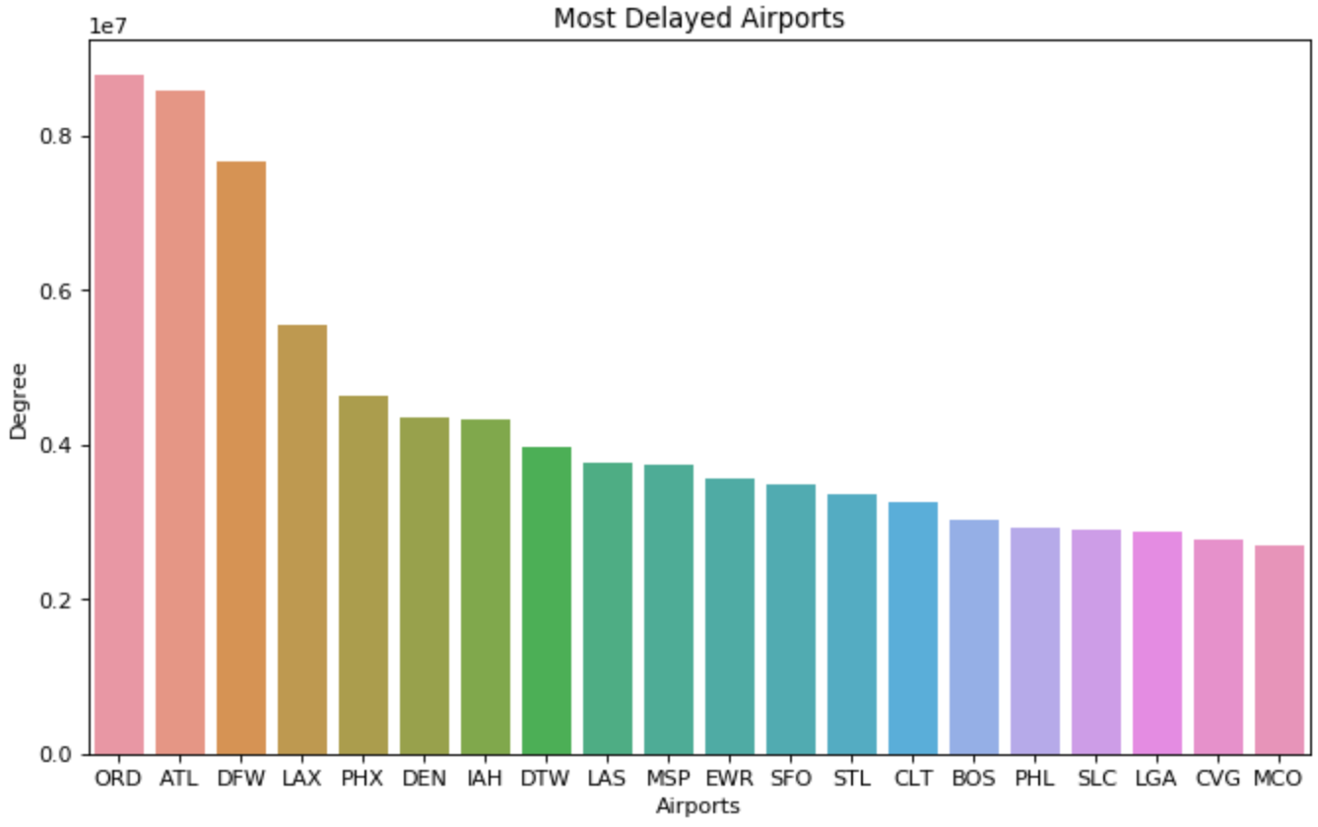
EDA - Delay Analysis - Airports
Cancelled flights by Airport:
LAX to LAS is most delayed route both direction followed by SFO to LAX
ORD most delayed airport followed by ATL
Flights delays are also often bi-directional
analyze delayed flights in detail

Slide 18
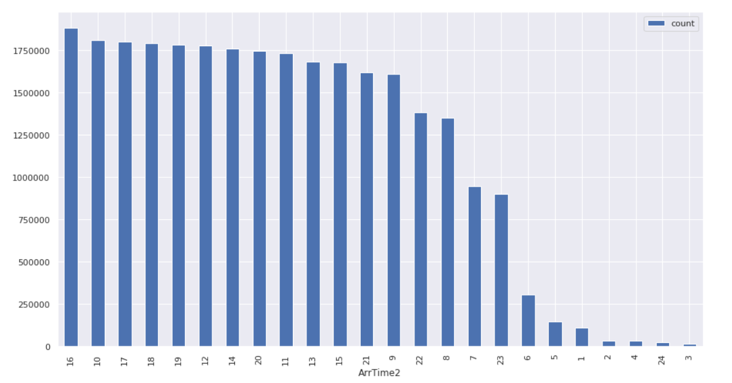
EDA - Delay Analysis (We need to change to %)
Late afternoon and noon time most likely to has delayed flights
Early morning flights has less flights thus less delays

Slide 19
EDA - Delay Analysis
Weather and NAS delays lead to longest delay times
Arrival delay and Departure delay are highly correlated
Arrival Delay are most related to Late Aircraft Delay
Flights are more likely to delay in the afternoon, especially noon times and early afternoon
Weekdays see more Delays than weekends like cancellations
Summer flights more likely to delay and winter days following
LAX to SFO, LAS flights has most delays but ORD has most delays inbound and outbound

Slide 20
Data clean - step 1
Since the two main focus of our project are cancellation and delay,
No matter a flight is cancelled/delayed or not, the origin airport and the destination airport shouldn’t be null values.
Df_1 = raw dataset w/ non-null ‘origin‘ and ’dest‘
Row dataset row_count = 123534969
Df_1 row_count = 122379717 (99.06%)

Slide 21
Data clean - step 2
Since we have a reasonable dataset w/ non-null ‘origin‘ and ’dest‘
Next, we drop some columns that we don’t need in our project
column | reason
‘CRSDepTime’, ‘CRSArrTime’, ‘CRSElapsedTime’ | Scheduled time can be calculated by actual time - delay
‘TailNum’ | Flight number is unique, no need for tail number
‘CancellationCode’ | It has 99% missing values

Slide 22
Data clean - step 3
Now, drop some unreasonable rows in the dataset, we split dataset by ‘cancelled’ (1 or 0)
Also, drop rows with missing values in Distance (2040 count) and AirTime (121 count)
Df_1 row_count = 122379717
Df_clean row_count = 121843347 (99.56%)
 | Dataset with ‘cancelled = 1’ | Dataset with ‘cancelled =0’
reason | time -related columns should be null | time -related columns should not be null
action | Drop rows with non-null values in time-related columns | Drop rows with null values in time-related columns

Slide 23
Data clean - step 4
After cleaning the dataset, in our analysis, we split the dataset into a few subsets for different uses.
df_clean | The full dataset
df1995 | The dataset after year 1995, which exclude all missing values except delay columns, and used to analyze cancellation
df2004 | The dataset from year 2004 to year 2007, which exclude all missing values, and used to analyze delay

Slide 24
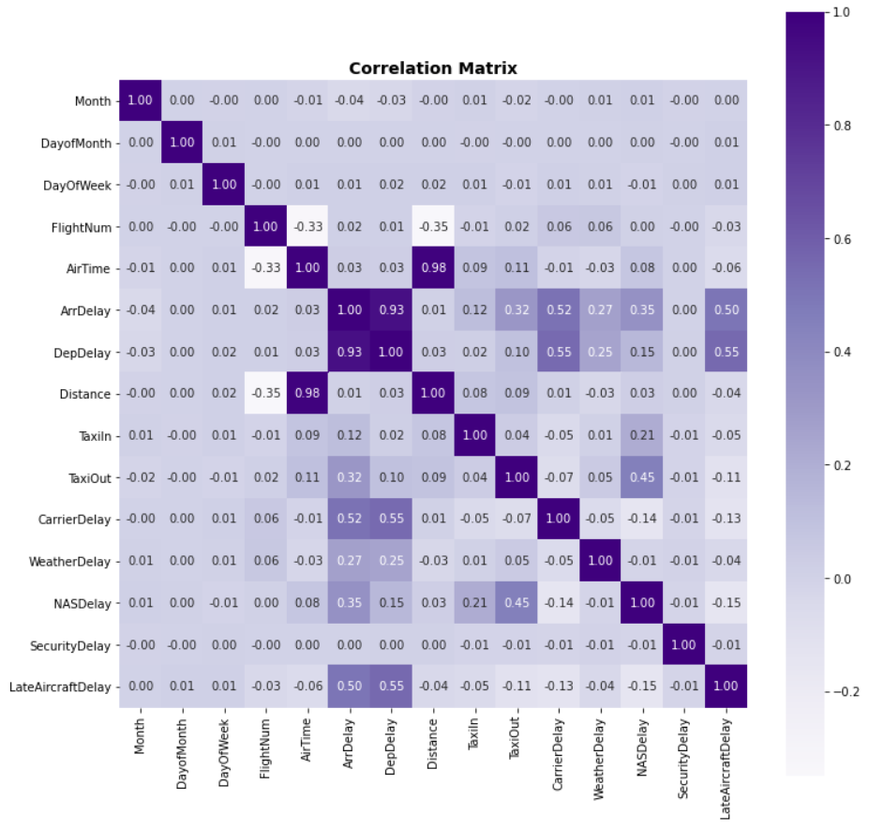
Correlation Analysis
df1995:
Distance is highly correlated to Air Time
Arrival delay is highly correlated Departure delay
We will drop Departure Delay in our delay model
We see a few delays reasons are correlated with Arrival Delay and Departure Delay
Taxi In and Out Time are also correlated with delays

Slide 25

Modeling
We use 80% of the sample as training data, 20% of the sample as testing data

Slide 26
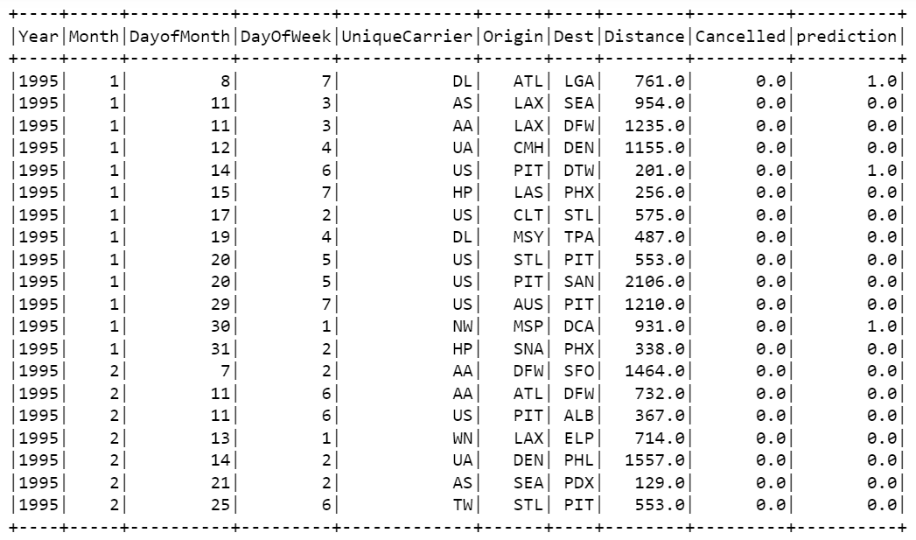
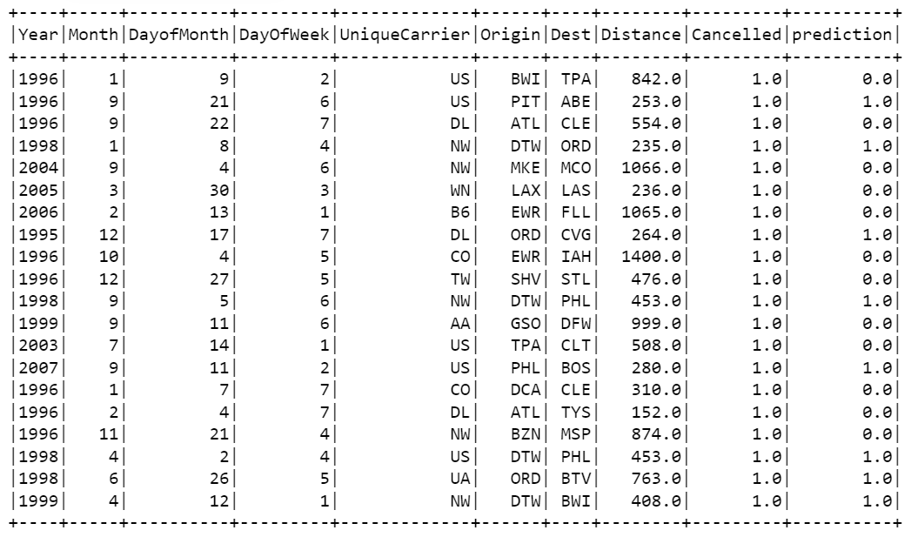
Topic I: Predict If Flights Are Cancelled Or Not

Slide 27
Topic I: Model Comparison
 | Logistic Regression | Random Forest
Accuracy | 0.6631 | 0.8963
F1 Score | 0.7941 | 0.9419
AUC Score | 0.6251 | 0.5642

Slide 28
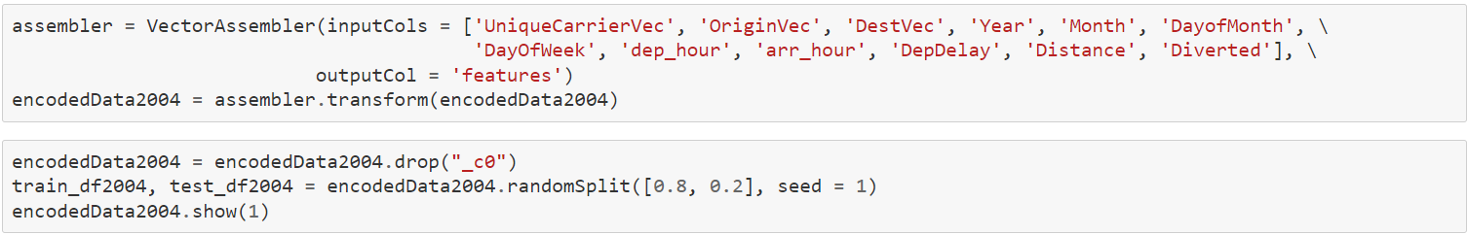
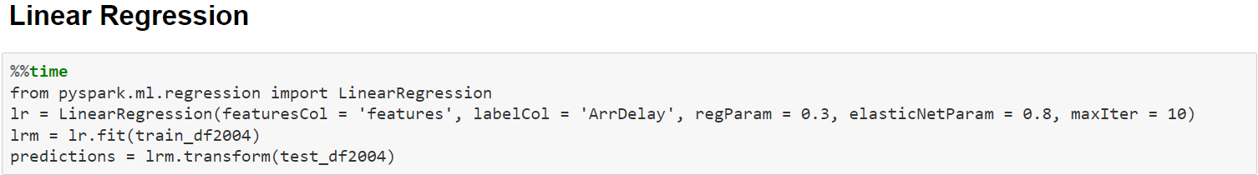
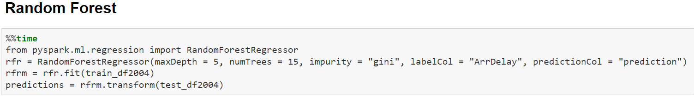
Topic II: Predict Time Of Arrival Delay Each Flight(WIP)

Slide 29
Topic II: Model Comparison(WIP)
 | Linear Regression | Random Forest
RMSE
MSE
MAE
R-Squared Score

Slide 30
Conclusion

Slide 31
Conclusion (WIP, will need results from model II)
Flights are more likely to be cancelled on Weekdays/ Winter/
Flights are more likely to be delayed on Weekdays/ Summer/
ORD airport has the most cancellation and delay
LAX-SFO flight has the most cancellation and delay

Slide 32
Further Study
https://www.researchgate.net/figure/a-Heat-map-displaying-the-delay-correlation-between-the-top-30-airports-b_fig2_350084821

Slide 33
THANK YOU!

